Slide 1


Slide 2
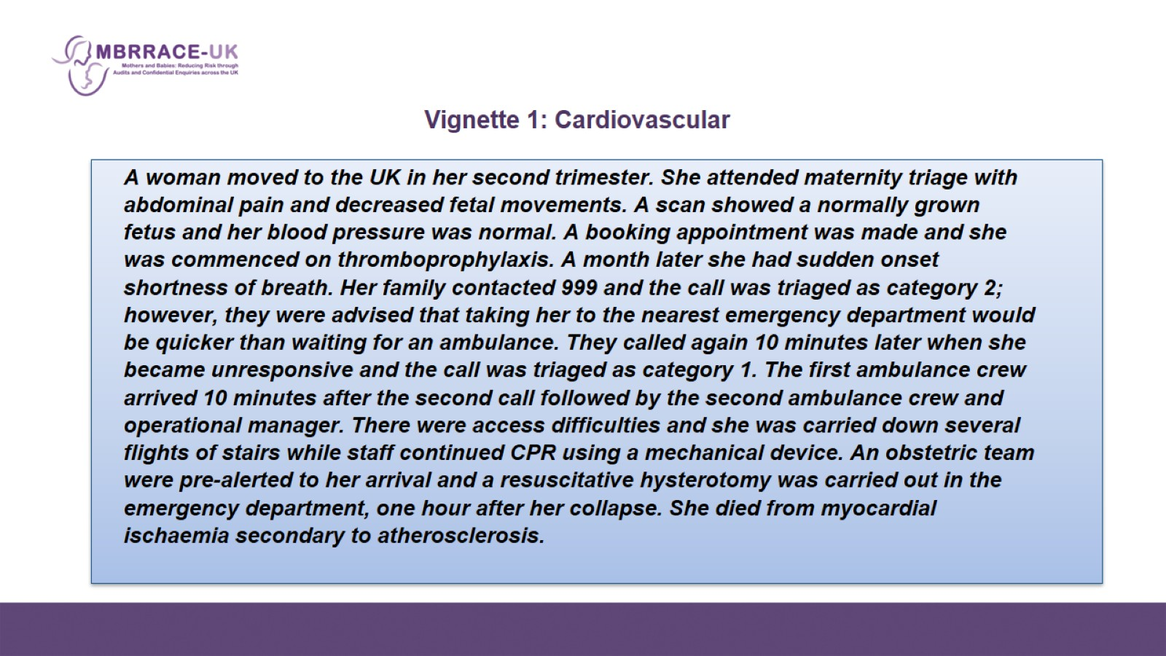

Slide 3
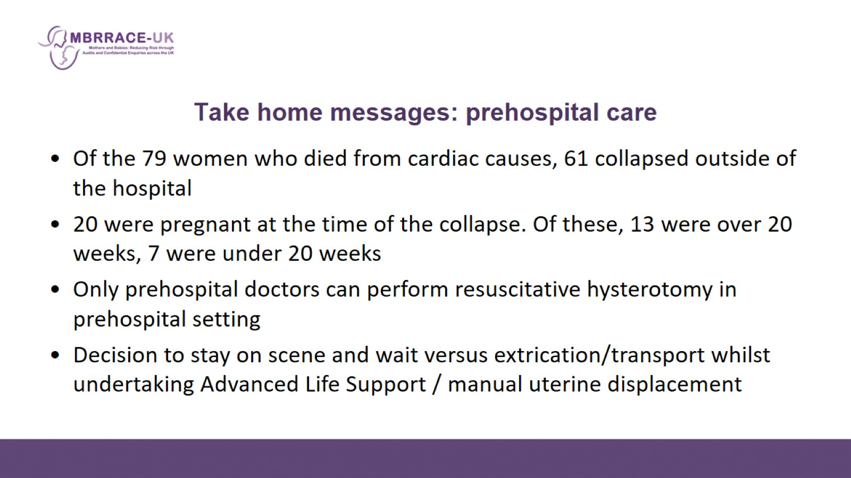
Take home messages: prehospital care

Slide 4
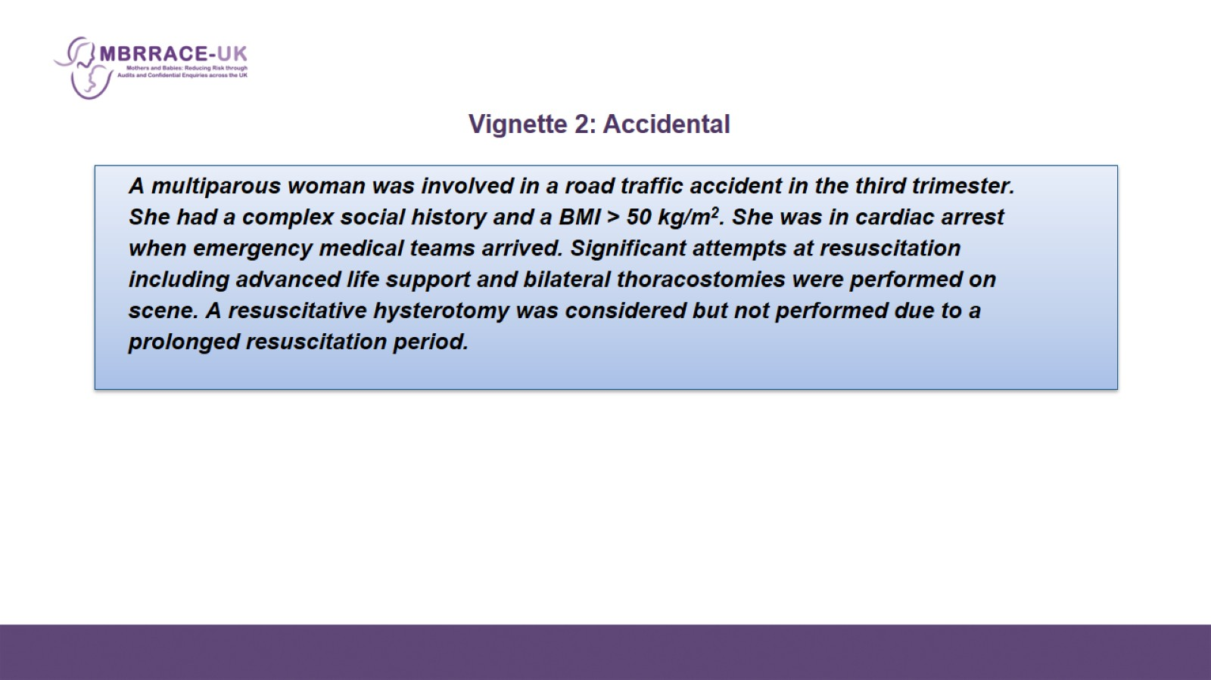

Slide 5
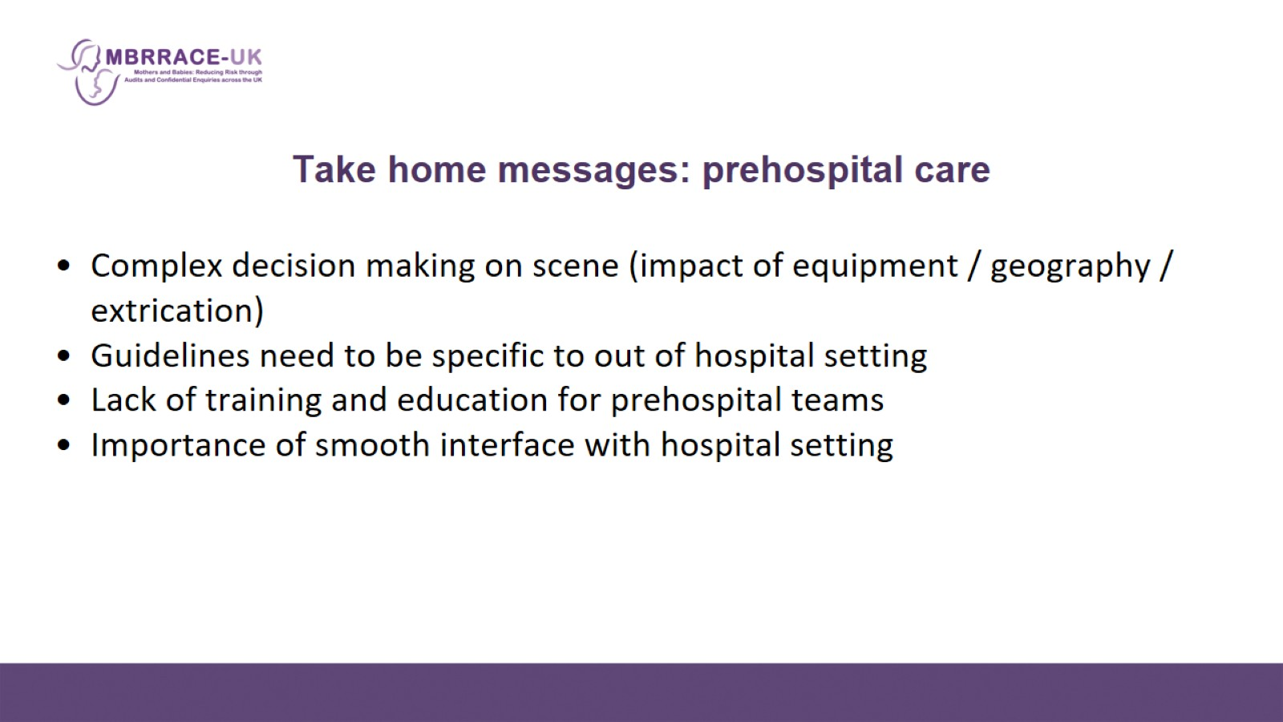
Take home messages: prehospital care

Slide 6
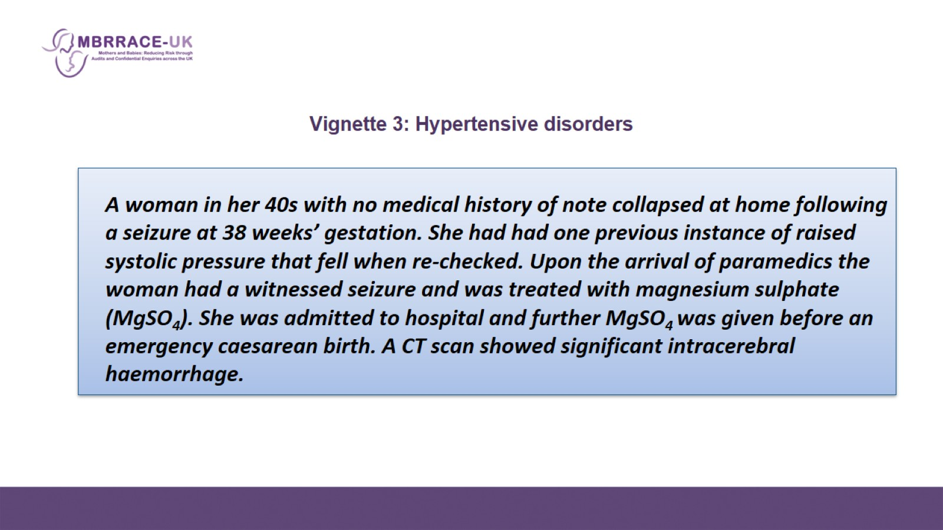
Vignette 3: Hypertensive disorders

Slide 7
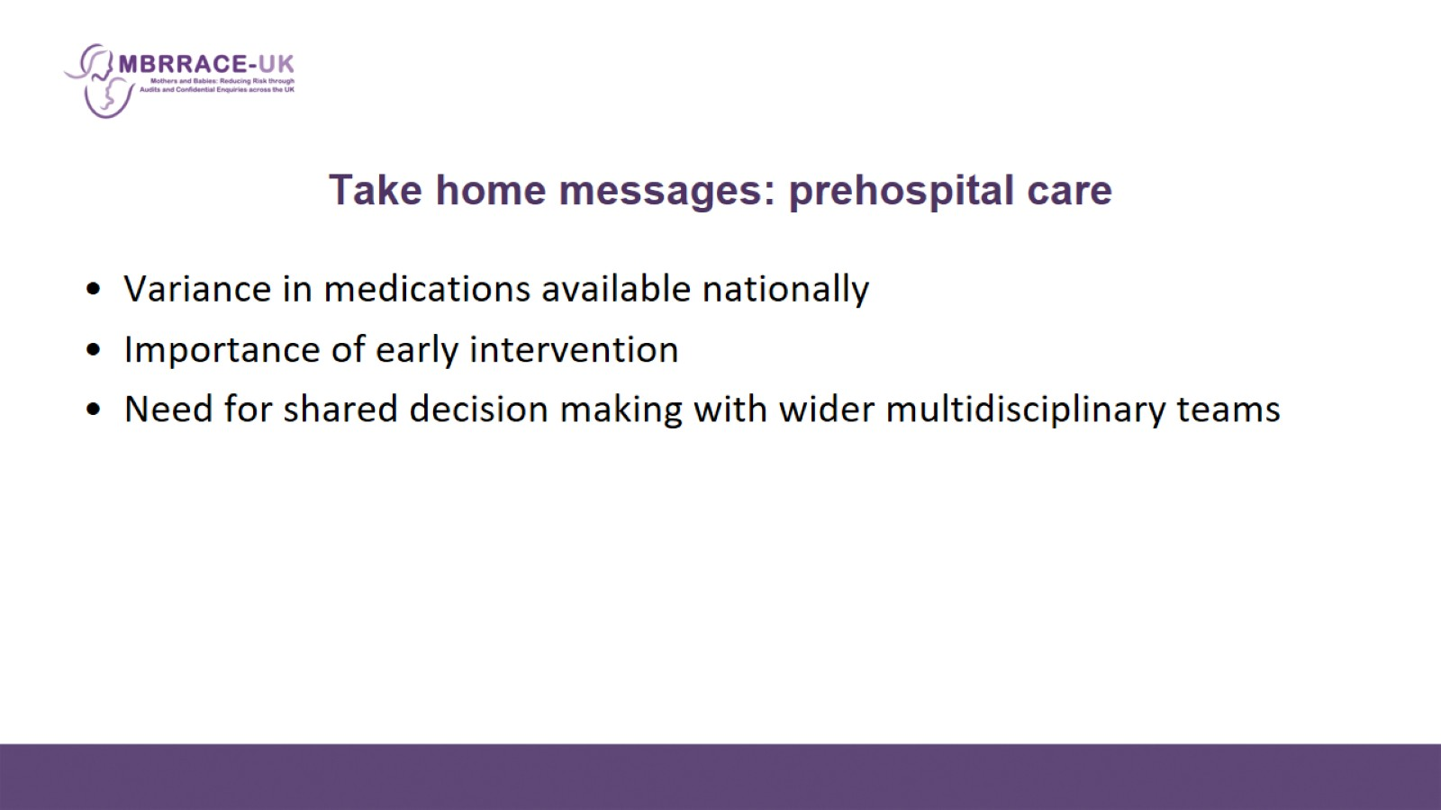
Take home messages: prehospital care

Slide 8
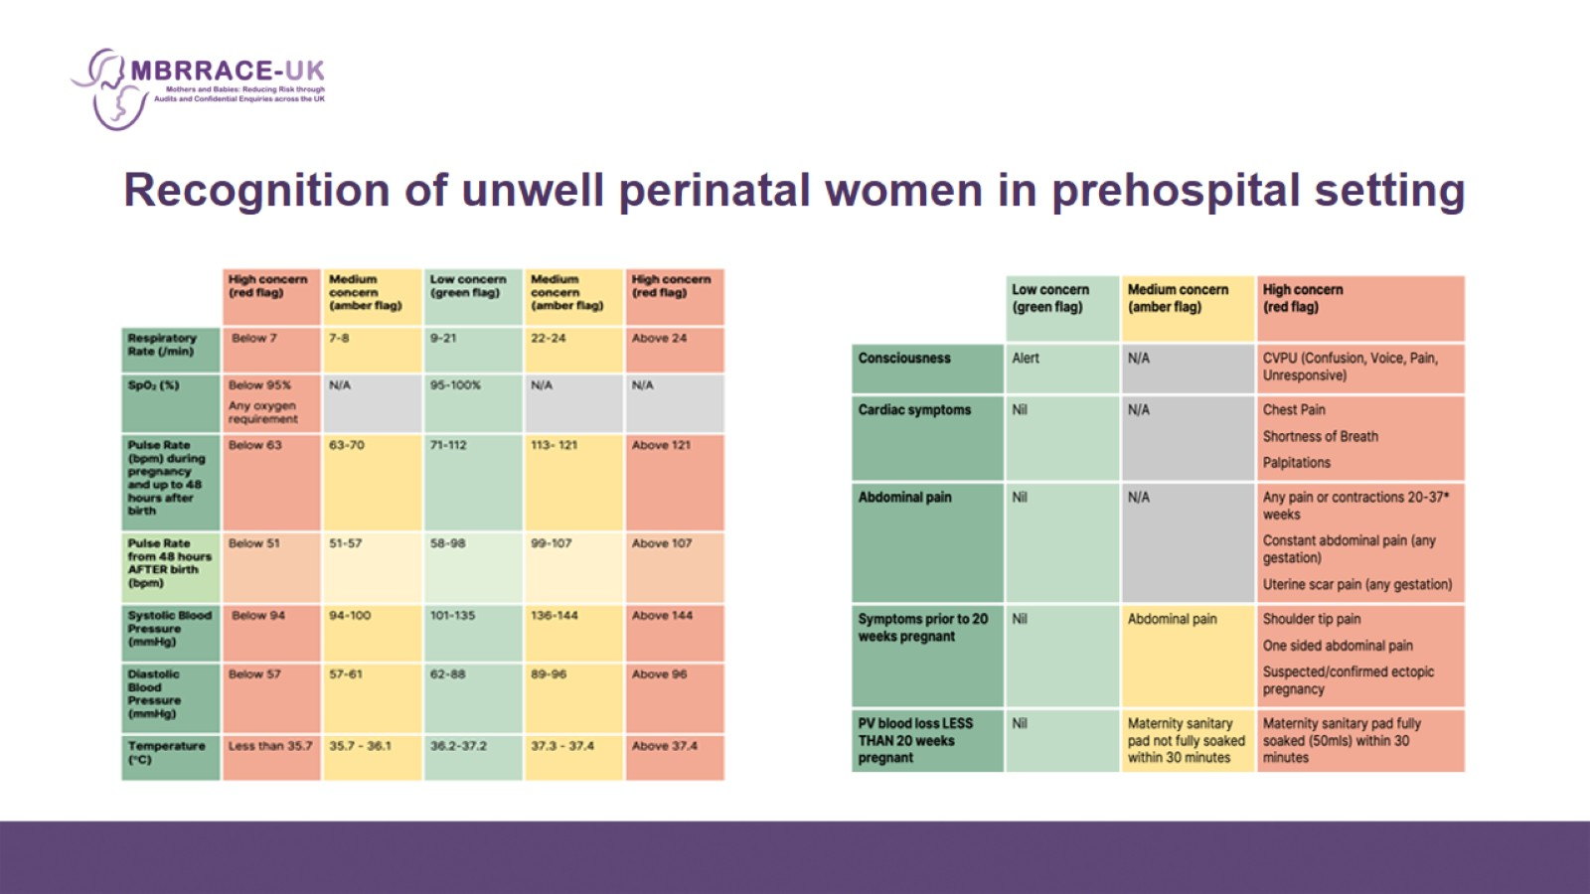
Recognition of unwell perinatal women in prehospital setting

Slide 9
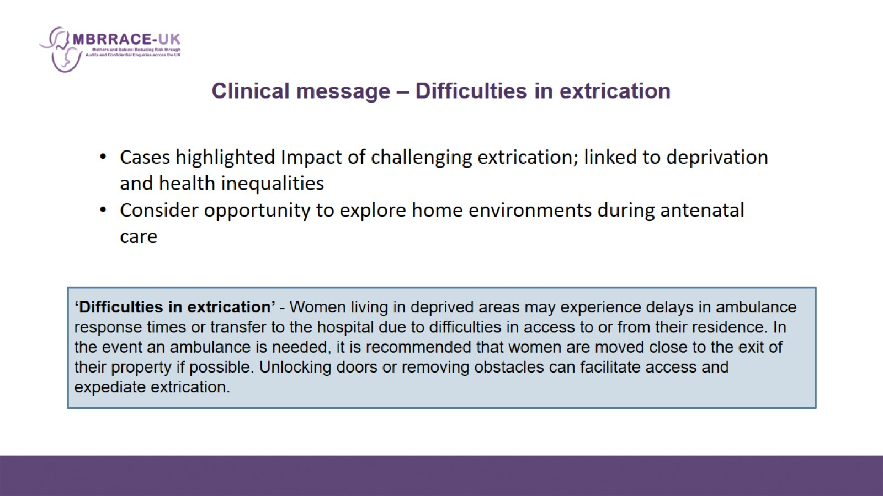
Clinical message – Difficulties in extrication

